Slide 1
Webmethods.io B2B
Provisioning, Design Time & Runtime Flows
Version 1.6
October, 2019

Slide 2
Contents
B2B Cloud Registration Process
Tenant Provisioning
Design-time flow
Runtime flow

Slide 3

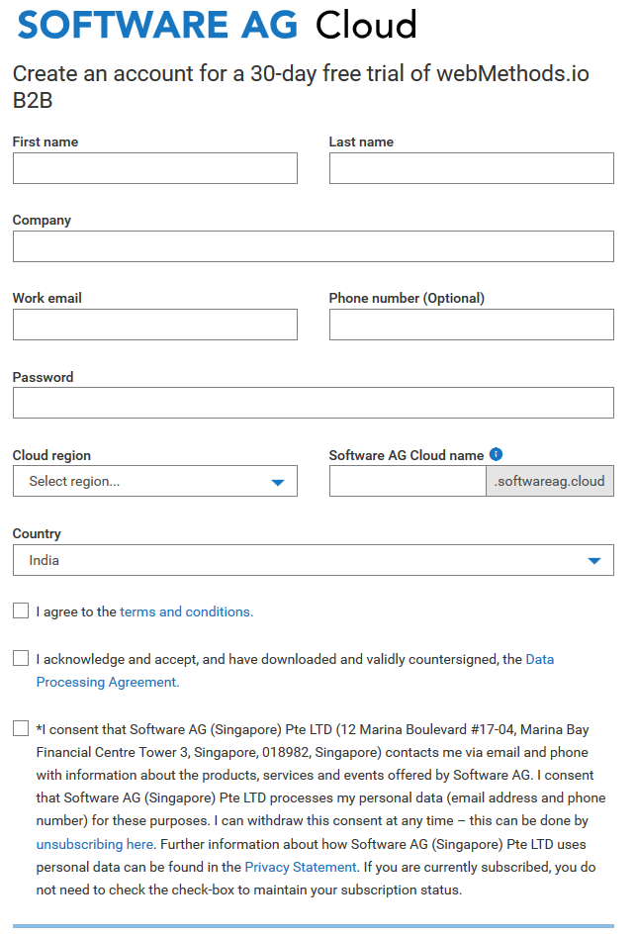
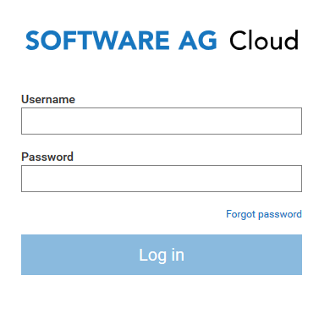
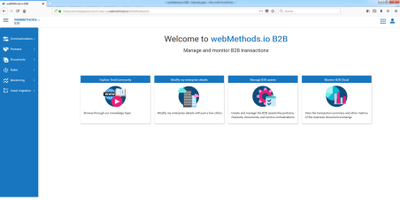
Tenant Registration Process
For Trial Accounts
Registration
Software AG Cloud
(Start Here)
[Link]
Software AG Cloud
Click on webMethods.io B2B, under Products
webMethods.io B2B Marketing Landing Page
Try for free
Customer
1
2
Login
B2B
[ Auto Provisioning ]
5
4
3
Notes:
https://www.softwareag.cloud/site/product/webmethods-b2b.html
OLD B2B Cloud Link (up-to Aug’2019)
1 - https://www.softwareag.com/corporate/products/cloud/default.html
2 - https://www.webmethodscloud.com/b2b
3 - https://www.softwareag.com/corporate/products/downloads/free_downloads/default
4 - https://www.webmethodscloud.com/b2b/#/reg
https://<tenant>.webmethodscloud.com/b2b/#/welcome

Slide 4
Tenant Provisioning

Slide 5
Tenant Provisioning
Key highlights
Integration Platform Tenant Infrastructure
B2B added as a capability to Tenant, similar to Cloud Deployment capability
Leverages the Kubernetes Cluster for B2B runtime
Every provisioning includes
Integration Cloud provisioning
B2B Cloud instance (one instance per tenant)
Only trial accounts supported, for Oct-2018
B2B database uses an independent store, different from the other products in webMethods.io Platform
Provisioned based on Tenant type (trial, basic, advanced or enterprise)

Slide 6
webMethods.io B2B – Editions (Oct’2019)
Basic Edition
Advanced Edition
Enterprise Edition
Cost per 1 GB stored
Cost per 1 GB stored
Cost per 1 GB stored
Limited to:
2 Environments
2 Standards
100 Trading Partners
10 Users
Limited to:
3 Environments
5 Standards
500 Trading Partners
Limited to:
4 Environments
Unlimited: Standards
Trading Partners
Users
Unlimited:
Users
One time Costs:
Standards version Example: X12 V4010
Additional Monthly Costs:
Additional Monthly Costs:
Additional Monthly Costs:
100,000 Transactions
500,000 Transactions
1,000,000 Transactions

Slide 7
Common Characteristics
Across all editions
Multi-zone availability
Encryption enabled
Daily Backup
Backup retention period 30 days
Enhanced monitoring and Performance Insights enabled
PIOPS (for Advanced Subscription)

Slide 8
Tenant Provisioning Flow
Kubernetes Cluster
Database Tier
External NGINX
(*/b2b/*)
Tenant A
MySQL - RDS
K8S Cluster Administrator
(b2b-provision)
B2B Runtime
CTP
(B2B provisioning)
Tenant DB
Tenant B
Tenant DB
Internal NGINX
(b2b context)
B2B Runtime
Ingress controller
WMIC Environment
…
…
IS
IS
IS

Slide 9
Design-Time Flow
Manage and Configure B2B Cloud

Slide 10
Design-Time Call Flow
Kubernetes Cluster
Database Tier
External NGINX
(*/b2b/*)
Tenant A
MySQL - RDS
K8S Cluster Administrator
B2B Runtime
CTP
(B2B Application)
Tenant DB
Tenant B
Tenant DB
Internal NGINX
(b2b context)
B2B Runtime
Ingress controller
(tenant instance resolution & routing)
PORT :: 5555
WMIC Environment
…
…
IS
IS
IS

Slide 11
Runtime Flow
Exchanging documents with B2B Cloud

Slide 12
Run-Time Call Flow
Kubernetes Cluster
Database Tier
External NGINX
(*/b2b/channels/*)
Tenant A
MySQL - RDS
K8S Cluster Administrator
B2B Runtime
CTP
(B2B Application)
Tenant DB
Tenant B
Internal NGINX
(b2b context)
Tenant DB
B2B Runtime
Ingress controller
(tenant instance resolution & routing)
PORT :: 5599
WMIC Environment
…
…
IS
IS
IS

Slide 13

B2B Runtime Deployment
Blueprint
Trading Partner
External Load balancer
Internal Ingress
Load balancer
Listen / Poll
Kubernetes Cluster
External Ingress Controller
Cluster Administration Pod
Internal Ingress Controller
Send
Ingess Controller
B2B Pod
Trading Partner

Slide 14
Kubernetes Cluster
Physical view

Slide 15
Kubernetes Infrastructure
Availability zones
External Load Balancer
AZ1
AZ2
AZ3
Route
NGNIX
NGNIX
NGNIX
Primary
Node
Node
Node
Fail-over
Node
Node
Node
Master
Master
Master
Master
ETCD
Persistence
ELK
RDBMS
Git
EBS

Slide 16
WEBMETHODS.IO - 2019
Logical View
Built.io Infrastructure
weMethods Infrastructure
UI / API
Run-flow
Trigger
CLI Client
Flow Editor UI
B2B
UI
Cloud Deployment
Unified Monitoring
Services
Queues
(SQS)
Instances
Kubernetes Infrastructure
Messaging
Hybrid Integration
Q Manager
Auth
Lookup
Namespaces
Cluster Management
Namespaces
Integration Server
(LIVE)
K8S Namespaces
Integration Server
(LIVE)
Integration Server
Listener
Cron
CLI
Messaging (PubSub)
Docker Registry
Trigger
Webhook
Compute
(Lamda)
Doc Store
B2B
Runtime
Cache
(Redis)
Mongo
S3
EFS
MySQL
Git
EBS
ELK
Notes:
Note:
Software AG Management Tenant, Tenant A, Tenant B, Shared, etc. are various namespaces with-in the Kubernetes Cluster
Tenant A and Tenant B are used to depict a sample tenant namespace components
With-in the namespaces, the runtimes are hosted as POD
Internal Kubernetes components, ingress settings, deployments etc. are not shown to avoid complexity
Some of the other low-level components (used by Integration Cloud like – UM, Memcache, Postfix mail server, etc) are excluded from the above diagram

Slide 17
Internal Topics

Slide 18
B2B Landscape
Connectivity, Configuration and monitoring
Channels
Provides connectivity to the partners for sending documents
Partner Management
Configure partner identity and define rules for processing documents
Document persistence options
Datastore
Transaction Monitoring
Dashboards
Search, Drill-down
Activities/Tasks
Resubmit/Reprocess

Slide 19
B2B Doc Store
CTP
Presentation Layer
Design-time interactions
B2B Application
B2B
API
DocStore Client API
K8S Cluster
Ingress Controller
Runtime Layer
Tenant specific B2B runtime, serving the requests
Tenant A
Tenant B
Tenant n
B2B
Runtime
B2B
Runtime
B2B
Runtime
Shared
Doc Store
Persistence Layer
Master Document Definition are stored in Doc store, while the user customization are store in the tenant’s storage
MySQL - RDS
(database per tenant)
Mongo DB
(Clustered)

Slide 20

B2B Container
Images & Containers
Containers
Doc Store
EDI
HL7
Images
HIPPA
Mongo
Access Layer - API
wM B2B Core Module
FIX
WmTN
WmTNExt
…
RN
FROM
wM Integration Server
(Lean base image)
…

Slide 21





B2B - Ci/CD
B2B
Runtime
wm-tn-core
WmTN
wm-tn-edi
WmB2B
WmChannels
is-base-image
wm-tn-core
webmethods-b2b
WmEDI
B2B
Application
WmEDIINT
b2b-ui
WmEDIforTN
WmEDIExt
WmEDIINTExt
B2B
Database
WmFlatFile
</>
b2b-db
wm-tn-edi
B2B
Doc store
wmb2b-store-client

Slide 22
B2B Related Applications
On WEBMETHODS.io INTEGRATION
Applications
Parse, interact and build integration using B2B
WmB2BProvider
webMethods.io B2B
webMethods.io B2B
Electronic Data Interchange
Parse, validate, and transform EDI messages received from the webMethods.io B2B
WmEDI
WmEDIProvider
AS2
EDI
…
Module to handle the Flat File Application handling. Partially managed by B2B team.
WmFlatFile
Flat File Applications
Flat File Application
Flat File Applications

